Slide 1
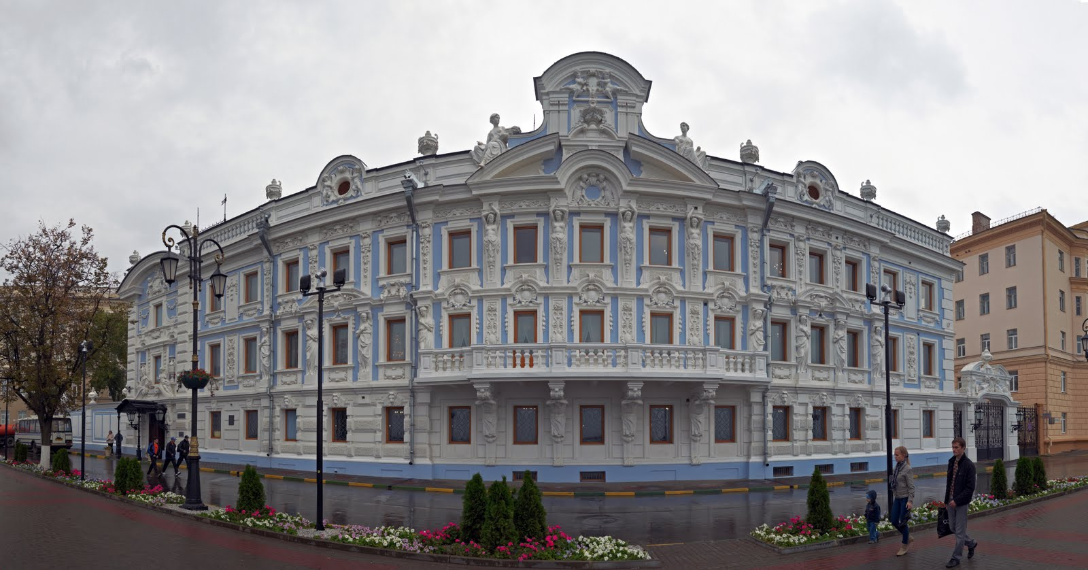
The Mansion of the Merchant Rukavishnikov
The history of the building.

Slide 2
Italian Palazzo
Sergey Mikhailovich decided to reconstruct the building and to make it like an Italian palazzo. There is a legend that his mother wanted neither to sell the house nor to leave it. So, the new building was constructed upon the old one.

Slide 3
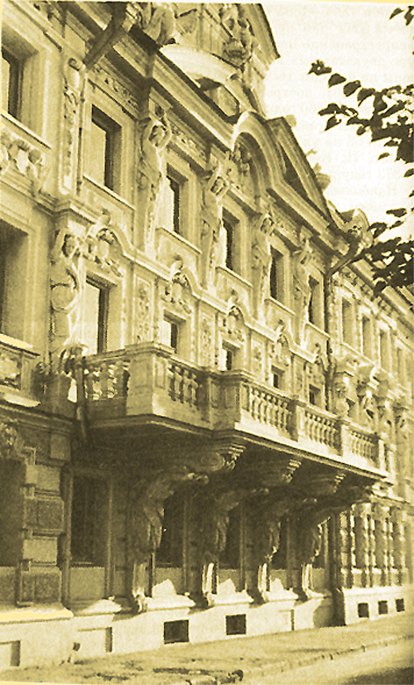
Pyotr Boytsov was the architect of the mansion.
The façade refinement was made by the sculptor Mikhail Mikeshin

Slide 4
This is the Mansion and the Upper Embankment at the beginning of the 20th century.

Slide 5
After the revolution
The house was nationalized after the Revolution and in 1924 it became the Nizhegorodsky regional museum.
Different kinds of exhibitions were held there.

Slide 6
The years of oblivion
In 1994 the museum was closed because of its poor conditions.
During the next 16 years it was being reconstructed.

Slide 7
The new life of the museum
Fortunately, in September 2010 it was brought back to life and was opened to the public.
Valery Shantsev handed over the symbolic key of the museum to its director, Veniamin Arkhangelsky.

Slide 8
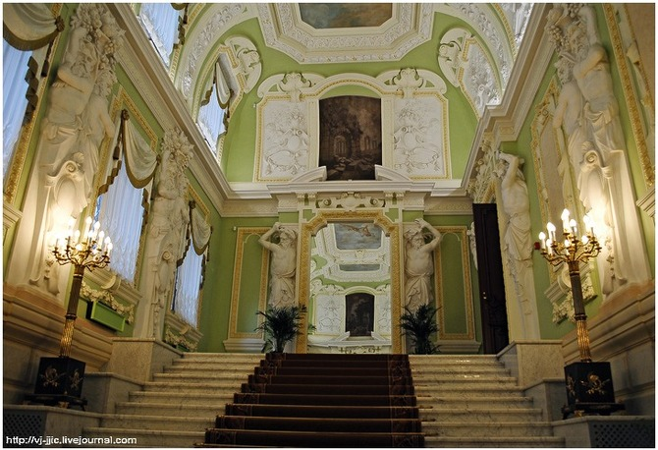
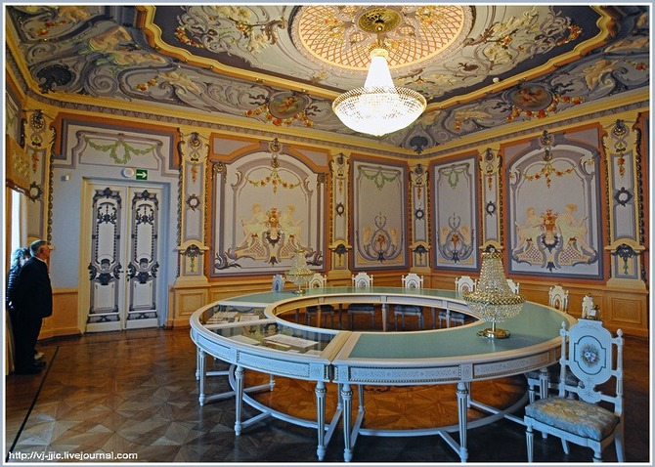
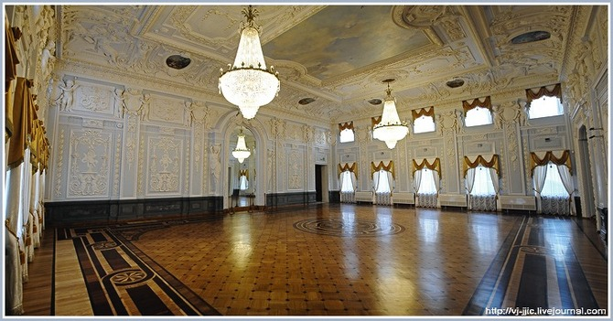
Now the Nizhegorodsky State Reserve-Museum of History and Architecture is very beautiful inside and outside.

Slide 9
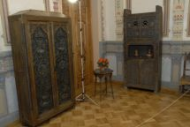
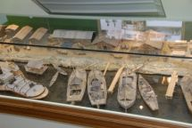
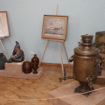
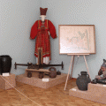
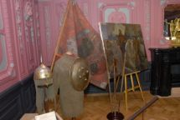
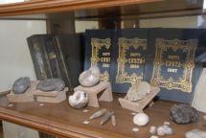
Different kinds of exhibitions are held here now

Slide 10
And here we are
Nikita Shavandin
Mikhail Mamaev
The students of the 8th form of school № 70

